Slide 1

Free Rooms App The app for that time of study needs!
Final Project by:
Christien Soosaipillai 100557844
Irfaan Ali 100400606

Slide 2


Free Rooms App
Created using Java 8 programming language.
Programmed with IntelliJ.
This application searches the school’s schedule (only fall 2016 for now) for available rooms that are unused at a specified time.

Slide 3

Description of the problem.
We decided to recreate Assignment #2 Part 3 from Scala into Java as it would be a useful desktop GUI application to have when in need of a free room to study at
This app would be handy to use if we possess access to the semesters’ schedule list.

Slide 4
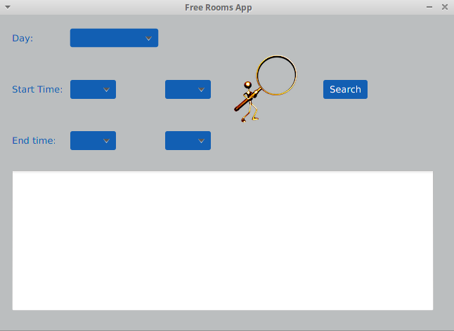

Description of the solution.
We made use of some Java’s classes and created a GUI to display the results of the search rather than simply printing to the terminal.
By giving a criteria, it returns all the free rooms that fit the search.

Slide 5
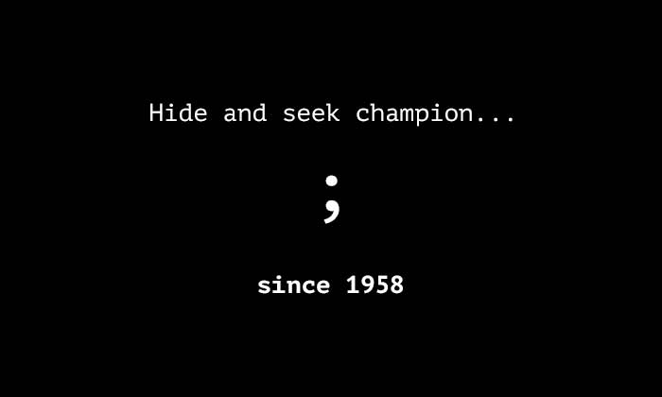
Discussion on the suitability of the language selection.
Java works well when implementing a UI into your program with numerous classes that tend to the user’s functional and graphical needs.
Downfall though, Java do tend to be more verbose than Scala.

Slide 6
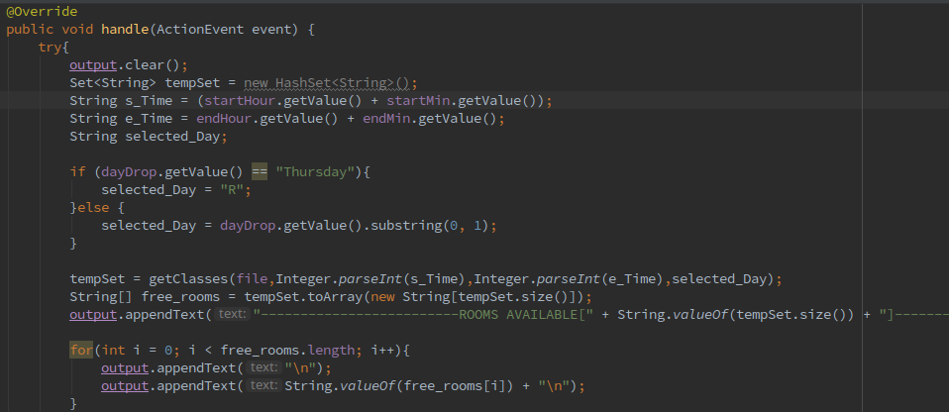
-Buttons
This is a snippet of an event handler. This was used to handle the event of the search button being clicked. First we clear the board and then we take our values from the drop down lists in the UI. These values are then passed onto the function to search through the file to find the applicable rooms.

Slide 7
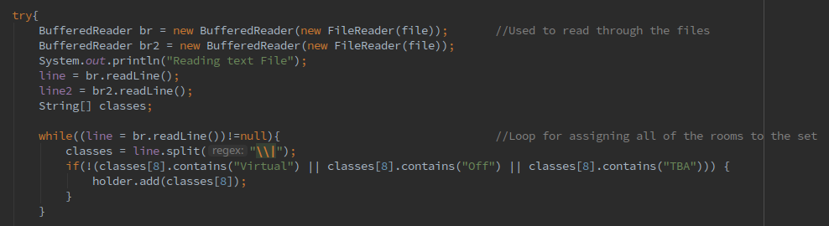
-Buffered Reader
This snippet was used to read the file and place the rooms into a set (ignoring the non-real rooms).
There are multiple buffers as we had to read through the file twice, once for adding rooms to a set and second to sift through the schedule file to find the rooms.

Slide 8
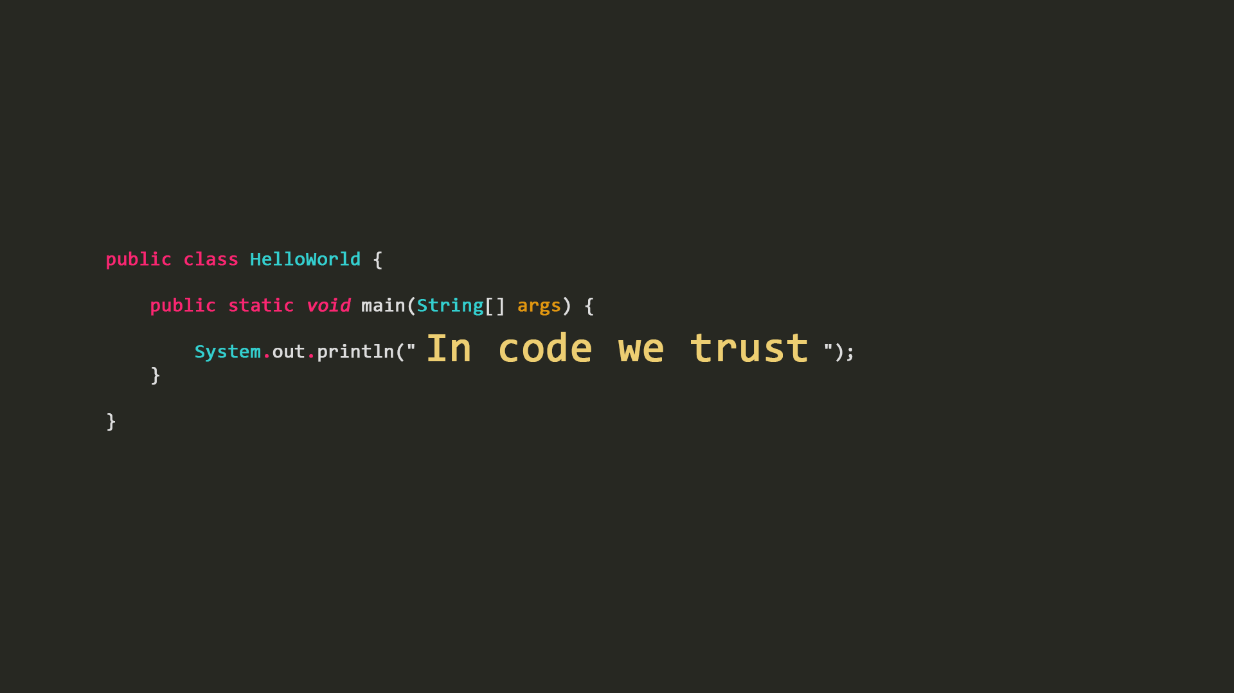
Thank You.
Any Questions?

